Slide 1
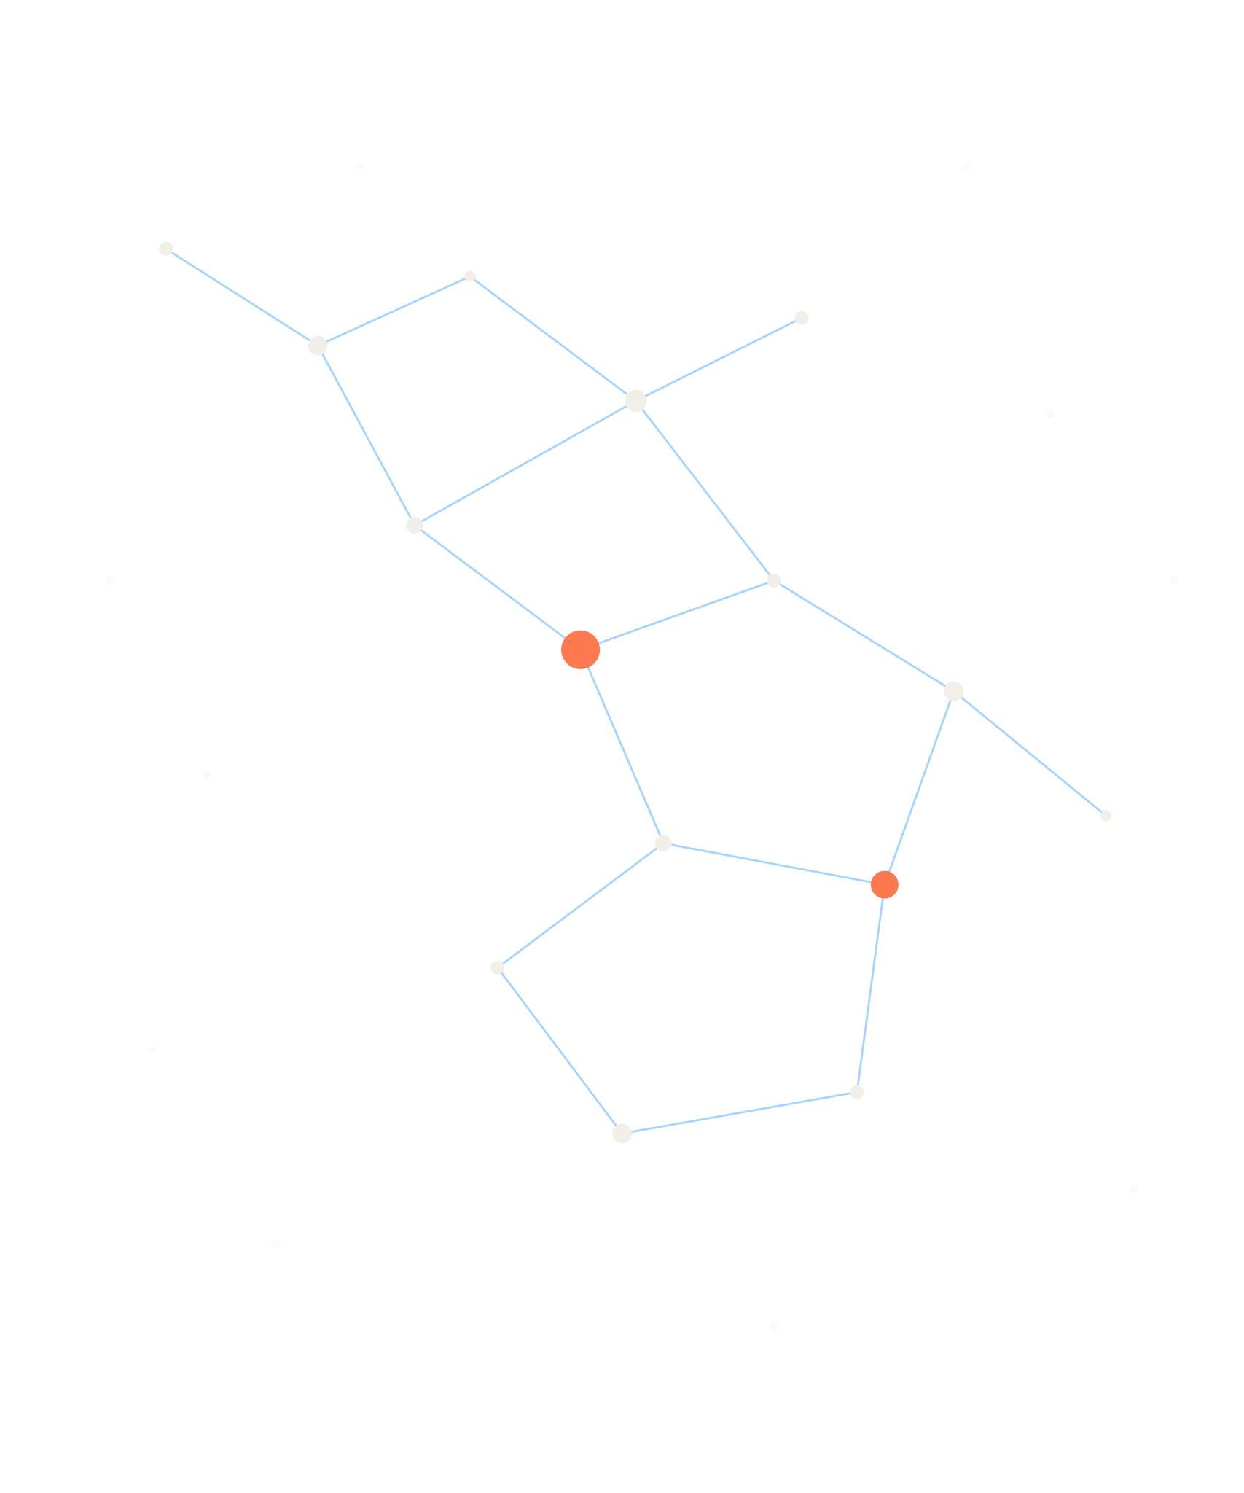
Points, Bodies, Systems
TOUCHDESIGNER MASTER CLASS 2
Point Operators (POPs) and how to design an interactive system around them
Jojo Zhou · Norwich University of the Arts · Creative Computing

Slide 2
Three short labs, then your own prototype
THE DAY · 6 HOURS
Time | Block | Mode
9:30 | Recap and bridge from Master Class 1 | Talk
10:00 | 1 · POP foundations | Talk + demo
10:30 | Lab 1 · Image to points, rebuilt with POPs | Lab
11:30 | 2 · Making points move | Demo
12:00 | Lab 2 · Living points | Lab
12:30 | Break | —
13:30 | 3 · Designing interaction | Talk
14:00 | Lab 3 · Body to points | Lab
16:00 | Show and tell | Crit

Slide 3

Last time we moved data around the points. Today we work on the points.
FROM MASTER CLASS 1
MASTER CLASS 1
MASTER CLASS 2
Instancing
POPs
Image → TOP to CHOP → channels → Geometry COMP instance page. Each step converts the data into a new format.
Image → TOP to POP → points that carry position and colour, on the GPU. They stay points the whole way through.

Slide 4
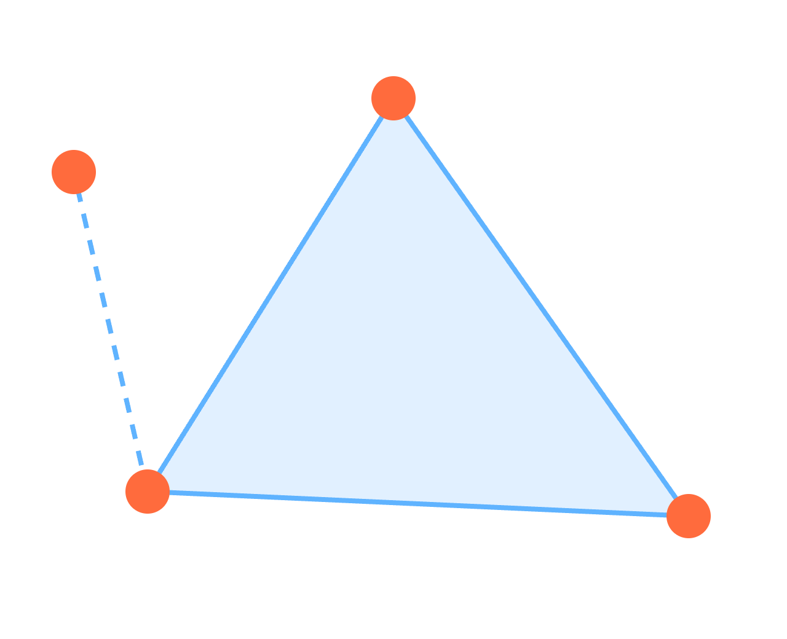
What is a POP?
1 · POP FOUNDATIONS
A Point Operator creates or changes 3D data on the GPU. Every POP holds three lists:
Points carry attributes: position, colour, anything you name.
Primitives say how points join: point, line, line strip, triangle, quad.
Vertices are the links from a primitive back to its points.
orange = points · blue = primitives

Slide 5
Attributes are the data. Name one and it exists.
1 · POP FOUNDATIONS
Attribute | Holds
P | Position (x, y, z)
Color | RGBA colour
N | Normal direction
PartVel | Particle velocity
_PointI | Point index (read-only)
Excite | Any name you invent
Three habits
Look: turn on attribute display in the POP viewer, or wire a POP to DAT to read the numbers.
Swizzle: P.y or P.yxz picks and reorders components.
Trust the pass-through: a POP only stores what it changes, so long chains stay cheap.

Slide 6
SOPs and POPs
1 · POP FOUNDATIONS
 | SOPs | POPs
Runs on | CPU | GPU compute shaders
Scale | Thousands of points | Millions of points
Data | Fixed attribute set | Any attribute you name
Instancing | Often via CHOPs or DATs | Read attributes directly
Still better for | Booleans, NURBS, meshes | —
Sources: Derivative, Learning About POPs; Interactive & Immersive HQ, POPs in TouchDesigner FAQ. Derivative asks for 4 GB graphics memory minimum, 8 GB recommended.

Slide 7
Over 100 POPs, four verbs
1 · POP FOUNDATIONS
Make
Shape
Move
Connect
Create or import points
Change attributes
Carry state frame to frame
Build lines and surfaces
Grid
Sphere
Pattern
TOP to POP
CHOP to POP
Point File In
Transform
Math
Noise
Field
Random
Lookup Texture
Proximity
Line
Line Thick
Copy
Polygonize
Feedback
Particle
Force Radial
Trail
Accumulate

Slide 8

Last week’s patch, in four operators
DEMO · 10 MIN
TOP
POP
POP
COMP + TOP
Video Device In
TOP to POP
Noise
Geometry → Render
TOP to POP turns pixels into points. Its Height (R) mode pushes points by brightness; Color (RGBA) carries the image’s colour.
No CHOPs, no instance page. Point size comes from the PointScale attribute.

Slide 9
Image to points, rebuilt
LAB 1 · 40 MIN
Camera or movie in, reduced to about 256 × 256
TOP to POP: depth from brightness
Carry the image’s colour onto the points
Add a Noise POP and animate it over time
Render: Geometry COMP, Camera, Render TOP
Check and stretch
Compare cook time with your Master Class 1 patch.
Switch Connectivity from points to triangles. What happens?
Save as lab1.toe. You will reuse it.

Slide 10
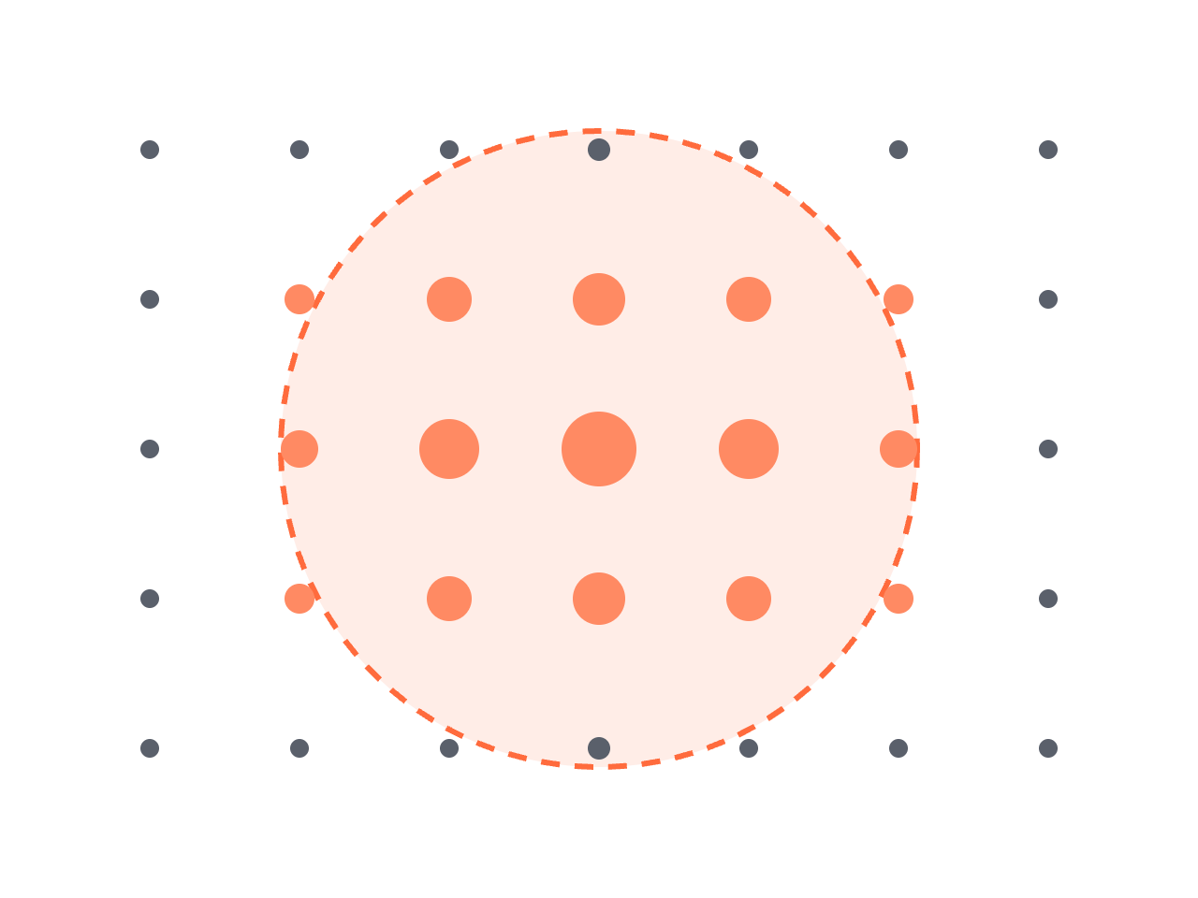
A field decides where something happens
2 · MAKING POINTS MOVE
Field POP writes a Weight from 1 inside a shape to 0 outside, with a soft edge.
Then let Weight scale an effect: on the Noise POP’s Map page, drive Amplitude from Weight.
Move the field’s centre with a hand, and the hand now has a zone of influence.

Slide 11



Memory: the particle loop
2 · MAKING POINTS MOVE
BIRTH + DEATH
FORCES
LOOP TARGET
Particle POP
Force Radial, Noise
Null POP
The Particle POP is built on the Feedback POP: its Target is the Null at the end, read back one frame later.
Only the Particle POP adds or removes points. Forces add to PartForce; velocity and position follow.

Slide 12

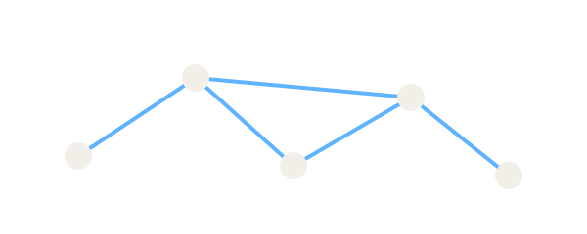

Lines turn movement into drawing
2 · MAKING POINTS MOVE
Trail POP
Proximity POP
Line Thick POP
Keeps the last N seconds of points and joins them into rows: a gesture leaves a mark.
Joins points closer than a distance: a network that forms and breaks as things move.
Gives lines a real width, so a trail renders as a ribbon rather than a hairline.

Slide 13
Living points
LAB 2 · 40 MIN
Emit particles from your Lab 1 points
Give them a life span and a little drag
Add one force: Force Radial or Noise
Add a Field POP and limit an effect to it
Draw with them: Trail or Proximity
Check and stretch
Move the field with an LFO CHOP. It is a stand-in for a hand.
Colour by age: map PartAge to Color.
Save as lab2.toe.

Slide 14
What does the body do, and what does the system say back?
3 · DESIGNING INTERACTION
You can now make points do almost anything. The hard part is deciding which movement should cause which change, and whether a person can feel that it did.

Slide 15
Three questions for every interaction
3 · DESIGNING INTERACTION
Do
Feel
Know
How does a person act on it? A button is discrete and precise. A gesture is continuous and expressive.
What comes back to the senses? Is the feedback immediate, and does it leave room for interpretation?
What does the person learn? Step by step (a path), or a picture of how the whole system behaves (a map)?
After Bill Verplank, Interaction Design Sketchbook (Stanford CCRMA course notes)

Slide 16
Mapping is the design
3 · DESIGNING INTERACTION
Shapes of a mapping
Anatomy of one interaction
Mapping | Example
One to one | Hand height → field size
One to many | Hand speed → noise, colour, trail length
Many to one | Two hands’ distance → force strength
Trigger: what starts it
Rules: what the system does
Feedback: how the person sees it
Loops: what changes over time
One to one is easy to read. Many to one tends to feel more like an instrument.
Hunt & Wanderley (2002), Mapping performer parameters to synthesis engines, Organised Sound 7(2); Saffer (2013), Microinteractions

Slide 17
Four rules from my own practice
3 · DESIGNING INTERACTION
Legible
Fast
A few clear mappings a person can learn
Responsiveness before more features
Felt
Bounded
Output the body can sense and answer
Some surprise, without losing control
“Set the stage, then shut up and listen.” — Tom Igoe

Slide 18


From MediaPipe to points: two routes
DEMO · 10 MIN
MediaPipe hand CHOP
Select one landmark
Field or Force centre
ROUTE A
All landmarks
Shuffle CHOP
CHOP to POP
ROUTE B
A: the hand as a control. Export x and y to a parameter. Simple, and works for one point of contact.
B: the hand as geometry. CHOP to POP makes one point per sample, so landmarks become points you can join, trail or emit from.

Slide 19
Body to points
LAB 3 · 40 MIN
Open lab2.toe and add the MediaPipe component
Route A: replace the LFO with your index fingertip
Route B: turn all 21 hand landmarks into points
Join them with Proximity, or trail them
Write your Do / Feel / Know in three sentences
Test it on someone
Swap seats. Say nothing. Can your partner find the rule in 30 seconds?
Write down what they tried first.

Slide 20
Four briefs
STUDIO SPRINT · CHOOSE ONE BRIEF
A · The mirror that remembers
B · Sound you can see
A body leaves traces that fade slowly. Camera or MediaPipe, Trail, Feedback.
Audio from Ableton or Max over OSC shapes a particle field. Fields, forces.
C · The hidden portrait
D · Out of the screen
An image as points, revealed only where a hand passes. TOP to POP, Field.
Points drive something physical or another app: DMX, LEDs, or OSC out.

Slide 21
What to show at 16:00
STUDIO SPRINT · 50 MIN
The rule
Show and tell: 2 minutes each
At least one technique from Master Class 1, and at least two POP verbs from today (make, shape, move, connect).
A live demo, or a 30-second recording
Your mapping, as one sketch
Do / Feel / Know, three sentences
One thing you would change
Start from your Lab 3 file. Build the input with a placeholder first, then plug in the real one.

Slide 22




Keep it real-time
WHEN IT GETS SLOW
Measure first. Performance Monitor or the Probe palette shows which operator costs the most.
Cap the count. Reduce input resolution and set a maximum number of points.
Stay on the GPU. Reading POP data back to the CPU (DATs, Python) can stall the frame.
Watch the frame rate with a Perform CHOP on screen while you test with a person.

Slide 23
Where to go next
READING AND RESOURCES
POPs
Designing interaction
Derivative · Learning About POPs
Igoe · Making Interactive Art: Set the Stage, Then Shut Up and Listen
Derivative Curriculum · Lesson 109, POPs: Working with Points
Verplank · Interaction Design Sketchbook
POPs Examples package · start with Overview.toe
Levin · Computer Vision for Artists and Designers
OP Snippets · Help menu in TouchDesigner
Hunt & Wanderley · Mapping performer parameters to synthesis engines
Interactive & Immersive HQ · SOPs to POPs
Höök · Designing with the Body

Slide 24
TO TAKE AWAY
1 Points carry their own data.
2 A field says where; an effect says what.
3 Build against a placeholder, then plug in the body.
4 Test with someone who has never seen it.

